Slide 1

What’s new in FakeXrmEasy (with .net core 3.1)
What’s new in v2.x of FakeXrmEasy
1

Slide 2






WhoAmIRequest ...
@jordimontana
@jordimontana82
https://www.linkedin.com/in/jordimontana/
What’s new in FakeXrmEasy v2.x
1

Slide 3
Why...
...Unit Testing?
What’s new in FakeXrmEasy v2.x
1

Slide 4
Why...
...Fixing bugs in Production...
What’s new in FakeXrmEasy v2.x
1

Slide 5
* Proactive as opposed to Reactive
* Bring issues closer to devs, where they’re easier to more cost efficient to fix
Why...
...Unit Testing?
What’s new in FakeXrmEasy v2.x
1

Slide 6




What is FakeXrmEasy?
https://github.com/jordimontana82/fake-xrm-easy
OSS Framework
177 Stars
140 forks
Aimed at developers using .net and Power Platform / CDS
Forks are like “copies” of the project
46 contributors
5+ Years
800k downloads
Who submitted at least 1 Pull Request
Started back in November 2014… time flies
Not too bad for a “low code” platform :)
What’s new in v2.x of FakeXrmEasy
1

Slide 7







#UnlimitedPower!
Cross-platform dev
What’s new in v2.x ...
.net core 3.1
Containerisation / Orchestration
Serverless
https://github.com/microsoft/PowerPlatform-CdsServiceClient (alpha release… you’ve been warned)
Presentation Title
1

Slide 8
* Use the right abstraction layer
* Install what you need only
* Massive refactorings
What’s new in v2.x ...
1 Nuget Package (v1.x) →
+6 Nuget Packages
Presentation Title
1

Slide 9
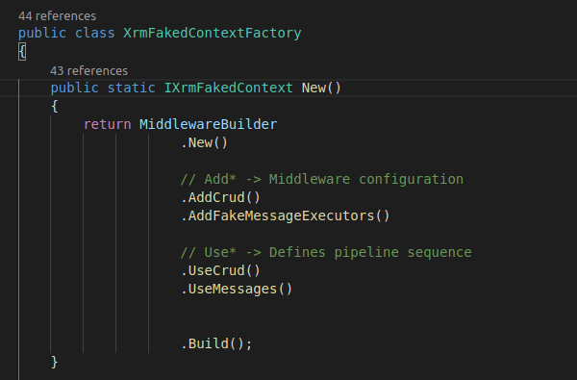
* There was up to 1 FakeMessageExecutor per OrganizationRequest in v1.x
* Now each OrganizationRequest runs through a configurable pipeline
* Much more decoupled and extensible implementation
What’s new in v2.x
New Middleware
Presentation Title
1

Slide 10
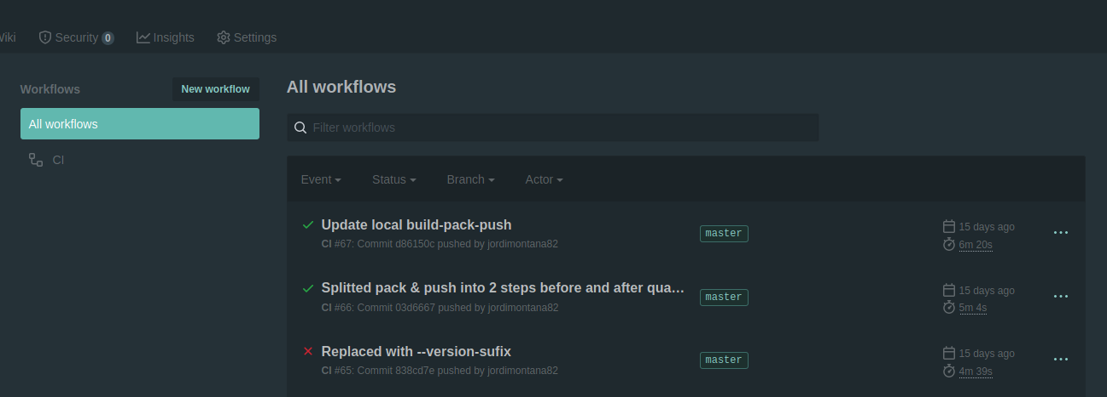
* Using AppVeyor in v1.x
* Built-in / integrated workflow
What’s new in v2.x
GitHub Actions
Presentation Title
1

Slide 11
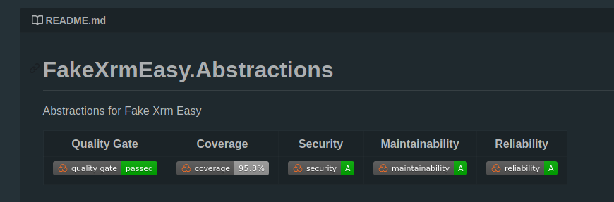
* Consistent Conventions / Rules across Pull Requests
* OWASP built-in checks (security)
* Code Smells
What’s new in v2.x
Sonar Quality Gate
Presentation Title
1

Slide 12
CONTENT SLIDE
Labore, ut int fugia ducimaximet estium, tem verio. Occatqui voluptatqui idessitas porecabor maximilis eatate perehent maxime reribus volessi taturestotas earum ut et il id minctium ernam, et eostent fugia volorro imetur mo quaeperum quia doluptatem. Ficietum conesti nctur? Facipiendae. Ducipis excepudit, volupta tisque pernatur alitasp ercide nossunt oditae. Et eaqui dis as porentiis aut volecul liquamendel eost alique vent porum dolupti a videniet que quaspe nonserum nes a et poriorestis volorep tiassitatem aperrum voluptis as quibus delit hilis isto quos culluptatem elitas am faccum harupti aecatem inim excersp eliasse disciasin rehent, solum aliquas sitasin est maxim dolorercias accabo.
Slide Subtitle
Presentation Title
1

Slide 13

THANK YOU!
Fill out survey: https://bit.ly/2A9VfiY

